Slide 1
“Easier NixOS self-hosting with module contracts”
By Pierre Penninckx
NixCon 2024

Slide 2



A bit about me
@ibizaman - Pierre Penninckx
Self-Hosting / Data Sovereignty
Staff Eng. @ on NGWaf fastly.com/fast-forward
CDN for Nixpkgs binary cache

Slide 3
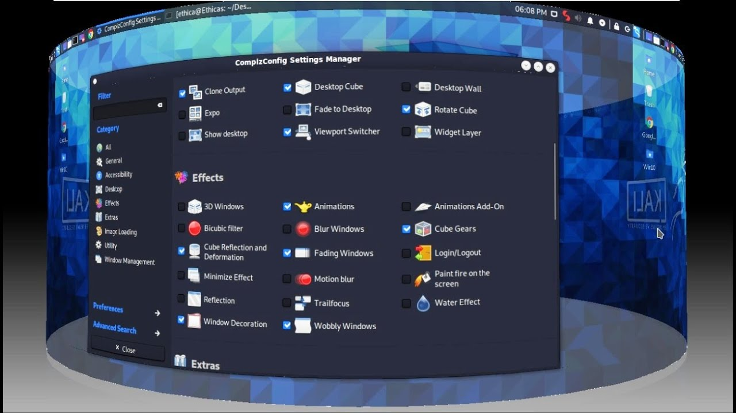
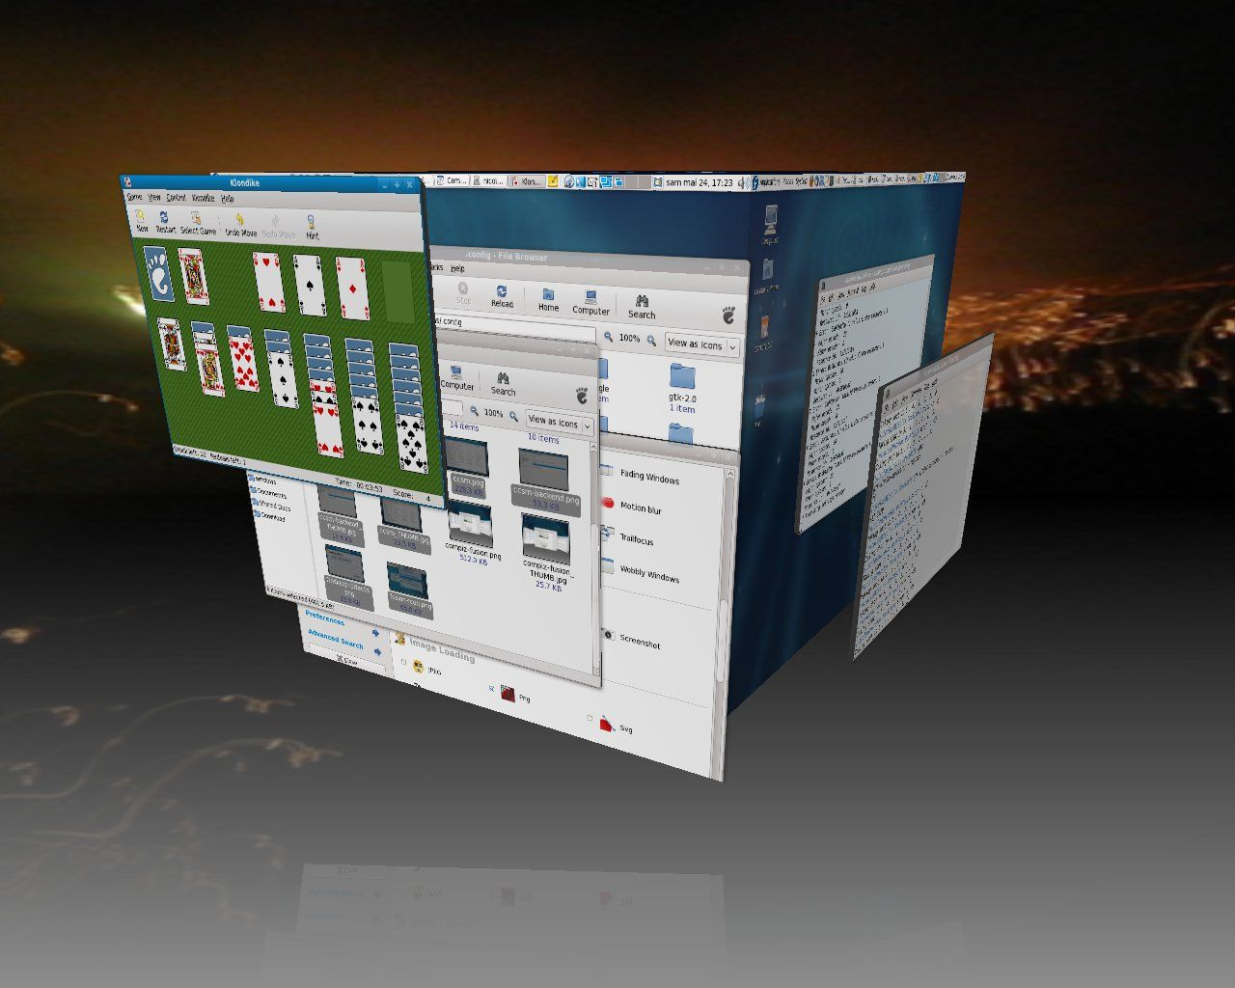
At the beginning
2008 - Switched from Windows to Ubuntu
for Compiz

Slide 4
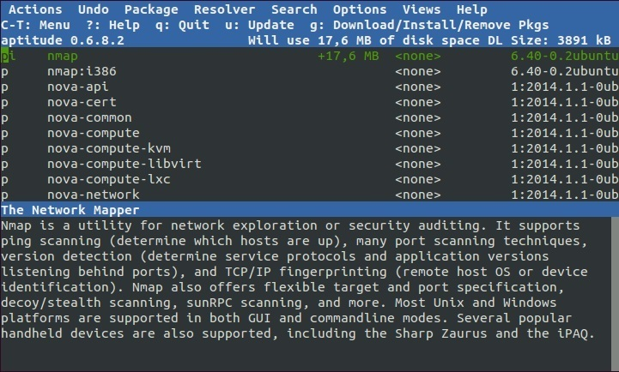
At the beginning
Really liked aptitude
Takeaway #1 and #2:
Good looks draw my attention
Catalog is cool

Slide 5

Went deeper
More bare metal
Understand root cause
Good docs
Takeaway #3
Onboarding and self-service

Slide 6

2019 - “Interactive Checklist” Configuration
Too many services
State = Unmanageable
Org + Org-Babel + TRAMP + Tangle

Slide 7
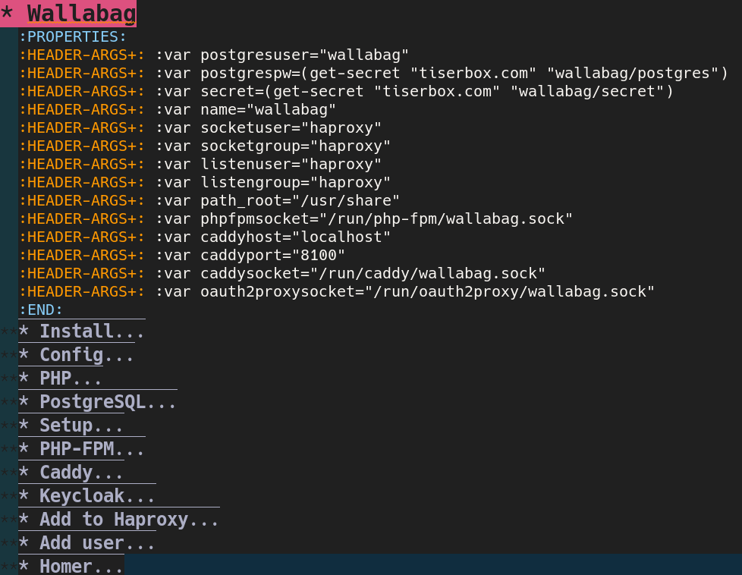
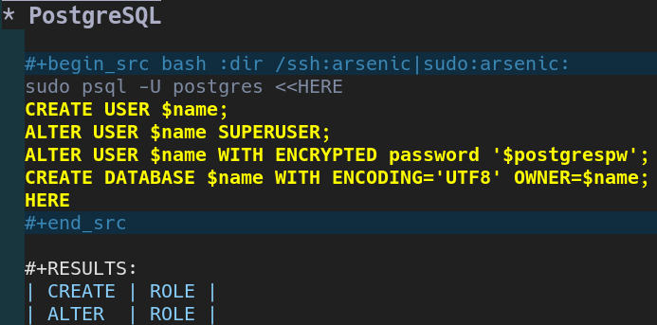
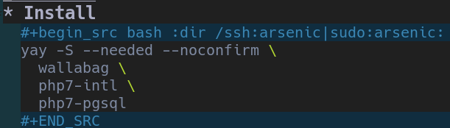
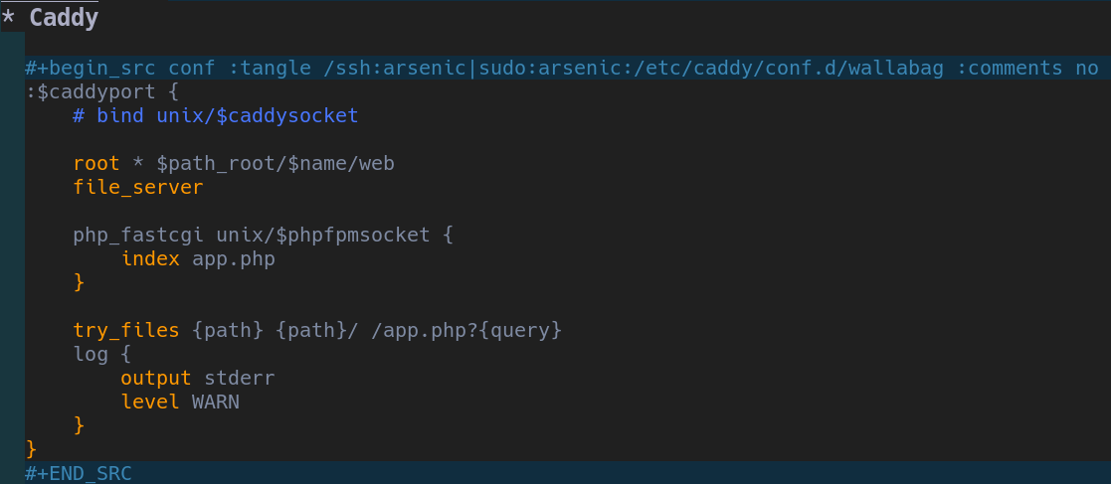
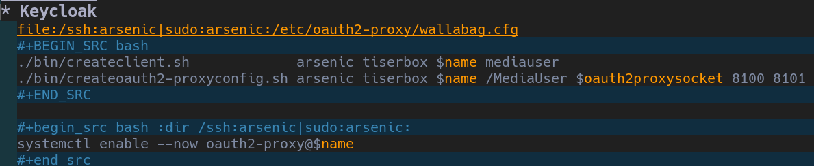
2019 - “Interactive Checklist” Configuration

Slide 8
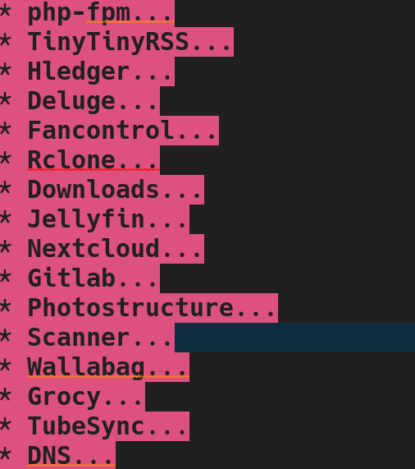
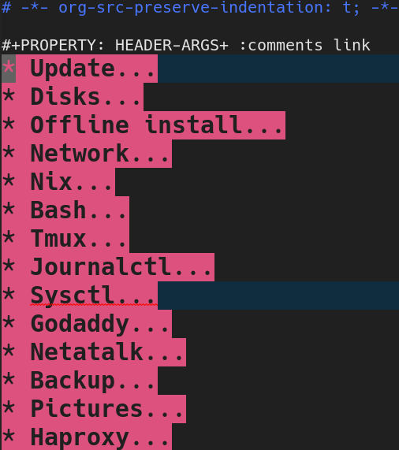
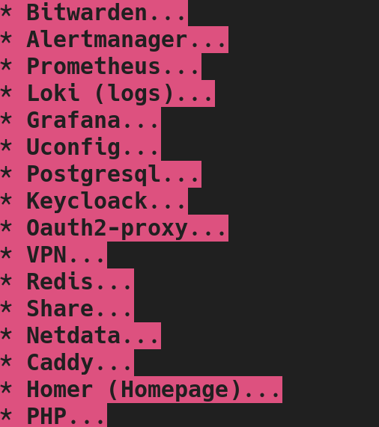

Dude, WTF
I was very proud.

Slide 9

Takeaway #4 and #5
Use a real programming language
One source of truth

Slide 10

Let’s give it a go
services.nextcloud = {
enable = true;
};
Nginx
PHP w/ PHP-FPM
Postgres or MySQL
Redis or Memcached

Slide 11
Checks ALL Takeaways
Good looks!
Catalog
Good docs?
Programming Language
One source of thruth

Slide 12
Too much is hardcoded
services.nextcloud = {
enable = true;
};
Nginx is always enabled
mkForce is a surgical tool
Other reverse proxies?
Paths to SSL certificates
Re-using work on Nginx, DB, Redis?

Slide 13
Implicit Contracts
web-apps/nextcloud.nix
Nginx
Redis
Memcached
APCU
Core
MySQL
Postgres
PHP
PHP-FPM

Slide 14
Explicit Contracts
web-apps/nextcloud.nix
Contracts
Reverse Proxy
Nginx
Caddy
Traefik
Core
PHP FastCGI
PHP
PHP-FPM
Cache
Redis
Memcached
APCU
Database
MySQL
PostgreSQL
SQLite

Slide 15
Separation of Concerns
web-apps/nextcloud.nix
Contracts
Reverse Proxy
Nginx
Caddy
Traefik
Core
Maintainer
Maintainer
Maintainer
Community
Maintainer
End User

Slide 16
Contracts already in Nixpkgs
services.<name>.enable
services.<name>.package
services.<name>.openFirewall
services.<name>.user
services.<name>.group
services.xserver.displayManager.<name>.enable = true;
services.xserver.desktopManager.<name>.enable = true;

Slide 17
Self Host Blocks
Building blocks for self-hosting with battery included.
PoC of Contracts
NixOS VM tests enforcing Contracts
A bunch of blocks (SSL, backup, SSO, VPN, ...) and services (Nextcloud, Vaultwarden, Home Assistant, …)

Slide 18
SSL Cert Generator Contract
Contract
domain
extraDomains
group
reloadServices
paths.cert
paths.key
systemdService

Slide 19
SSL Cert Generator Contract
Generate Self Signed
shb.certs.cas.selfsigned.myca = {
name = "My CA";
};
domain
extraDomains
group
reloadServices
paths.cert
paths.key
systemdService
shb.certs.certs.selfsigned."example.com" = {
ca = config.shb.certs.
cas.selfsigned.myca;
domain = "example.com";
extraDomains = [ "www.example.com" ];
};

Slide 20
SSL Cert Generator Contract
Generate Let’s Encrypt
shb.certs.certs.letsencrypt."example.com" = {
dnsProvider = "linode";
adminEmail = "admin@example.com";
credentialsFile = /path/to/secret/file;
domain = "example.com";
extraDomains = [ "www.example.com" ];
};
domain
extraDomains
group
reloadServices
paths.cert
paths.key
systemdService

Slide 21
SSL Cert Generator Contract
Use Self Signed
domain
extraDomains
group
reloadServices
paths.cert
paths.key
systemdService
let cert = config.shb.certs.certs.
selfsigned."example.com";
in {
services.nginx.virtualHosts."example.com" = {
sslCertificate = cert.paths.cert;
sslCertificateKey = cert.paths.key;
};
${cert}.group = "nginx";
${cert}.reloadServices = [ "nginx.service" ];
systemd.services.nginx = {
after = [ cert.systemdService ];
requires = [ cert.systemdService ];
};
}

Slide 22
SSL Cert Generator Contract
Use Let’s Encrypt
domain
extraDomains
group
reloadServices
paths.cert
paths.key
systemdService
let cert = config.shb.certs.certs.
letsencrypt."example.com";
in {
services.nginx.virtualHosts."example.com" = {
sslCertificate = cert.paths.cert;
sslCertificateKey = cert.paths.key;
};
${cert}.group = "nginx";
${cert}.reloadServices = [ "nginx.service" ];
systemd.services.nginx = {
after = [ cert.systemdService ];
requires = [ cert.systemdService ];
};
}

Slide 23
SSL Cert Generator Contract
- config.shb.certs.certs.selfsigned."example.com";
+ config.shb.certs.certs.letsencrypt."example.com";
End User has the Final Word

Slide 24
Why contracts
++
Program against abstraction
Verified with NixOS VM tests
Users pick implementation
Share code
Rule of 3
--
Need planning
Too opinionated?
Leaky abstraction?

Slide 25

Links
ibizaman/selfhostblocks
#selfhostblocks:matrix.org
blog.tiserbox.com

Slide 26

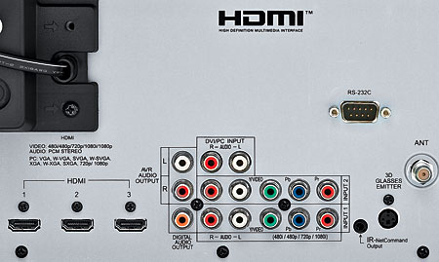
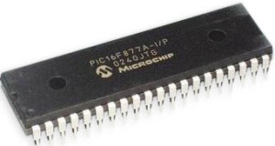
Toyed with Electronics
Mitsubishi WD-73837
Assembly
vs ESPHome
Takeaway #3:
Abstraction is a Key enabler

Slide 27


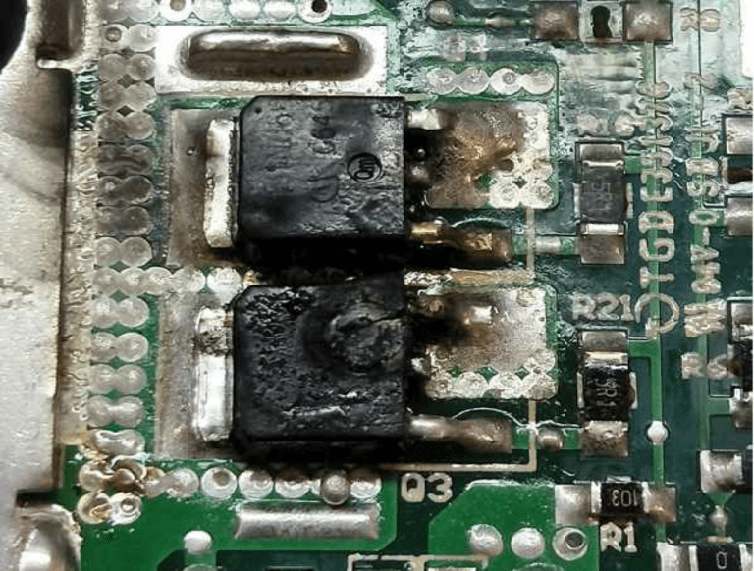
2023 - Start Anew

Slide 28
2017 – Vim to Emacs
Tried learning Vimscript
Coworker suggestion
Elisp clicked for me
Takeaway #4: hard must be justified

Slide 29
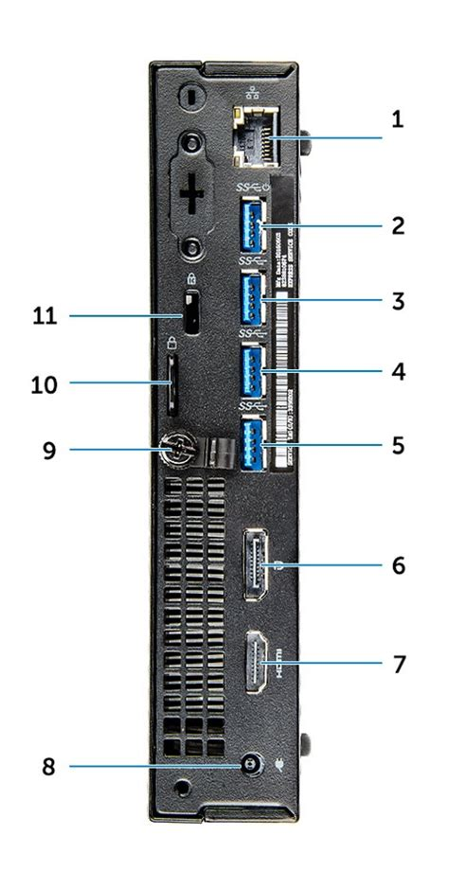


A New Server
Dell OptiPlex 7050 MFF
Refurbished
4 x USB 3.0!

Slide 30
More Services
Syncthing
LVM + mdadm
Nextcloud
Haproxy
VPN
DynDNS
Keycloak (SSO)
TinyTinyRSS
Hledger
Rclone (sync w/ dropbox)
Jellyfin
Gitlab
Wallabag
Grocy
Restic (Backup)
Scrutiny
Homer (Dashboard)
...
UNMANAGEABLE

Slide 31

Dab into Haskell
vs Python at work
Reflex FRP
Tutorial had me excited
Learned about rec
Uses nix to build
  Oh no, one more build system to learn...

Slide 32
Takeaway #5 and #6
State is HARD
Automate state migration

Slide 33


First Server
2009 - Converted my desktop to a server

Slide 34

What Makes Nix Good for Self Hosting?
State

Slide 35
What Makes Nix Good for Self Hosting?
State
Atomic Update
Atomic Rollback
Functional
Declarative
Deploys
Secrets
Modules
Systemd
Tests
All in Nix!

Slide 36
?!
State - DATABASES
Atomic Updates
Atomic Rollback
Deploys
Secrets
Modules
Systemd
Tests

Slide 37

That’s for another talk...
State - DATABASES

Slide 38
Lack of reusability
Nextcloud requires manual setup of:
  Backup solution
  LDAP integration
  SSO integration
Other services implement one or more of those
How can we reuse work and not duplicate?

Slide 39
Separation of Concerns
<insert name here> maintainer shouldn’t be an expert in:
Security
Reverse proxies
Databases
Caches
Backup
Monitoring
They should be <insert name here> experts.

Slide 40
Contract for Reverse Proxy
services.reverse_proxy.nginx.mynginx = {
enable = true;
# Config specific to Nginx
};
services.nextcloud = {
enable = true;
reverse_proxy =
config.services.reverse_proxy.nginx.mynginx;
};

Slide 41
Contract for Reverse Proxy
services.reverse_proxy.nginx.mynginx = {
enable = true;
# Config specific to Nginx
};
Contract
services.nextcloud = {
enable = true;
reverse_proxy =
config.services.reverse_proxy.nginx.mynginx;
};

Slide 42
Contracts are Reusable
web-apps/nextcloud.nix
Reverse Proxy
Backup
Core
PHP FastCGI
Monitoring
Cache
LDAP
<insert name here>.nix
Database
SSO

